Slide 1
Designing a Coaching and Mentoring Programme: Leadership and Management

Slide 2
Mentoring is a long-term process based on mutual trust and respect. Coaching, on the other hand, is for a short period of time.
Mentoring is more focused on creating an informal association between the mentor and mentee, whereas coaching follows a more structured and formal approach

Slide 3
Many types of mentoring:
Youth mentoring
Correctional Institutes
Religious
Craftmanship
Etc
Focus of this lecture: Leadership and Management Mentoring and Coaching

Slide 4
Differences between coaching and mentoring
short-term versus Long-term
Few resources v. many resources
Low level occupations v. professional, technical, managerial
Current job v. future job
But both are about L……..
and P…………

Slide 5
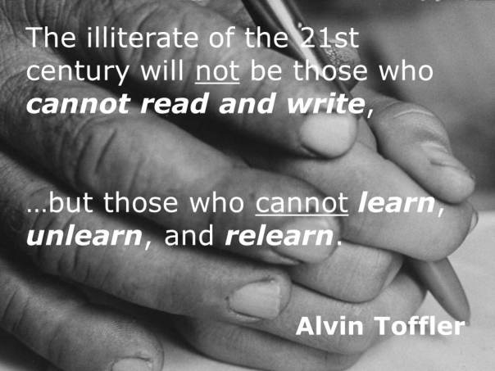

Slide 6
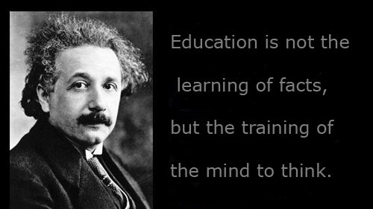

Slide 7
Designing a coaching and mentoring programme

Slide 8
Coaching, Training, Development, Mentoring, Counselling….etc
All are aspects of HRD focused on learning

Slide 9

(Confucius) HRD IS SILENT

Slide 10
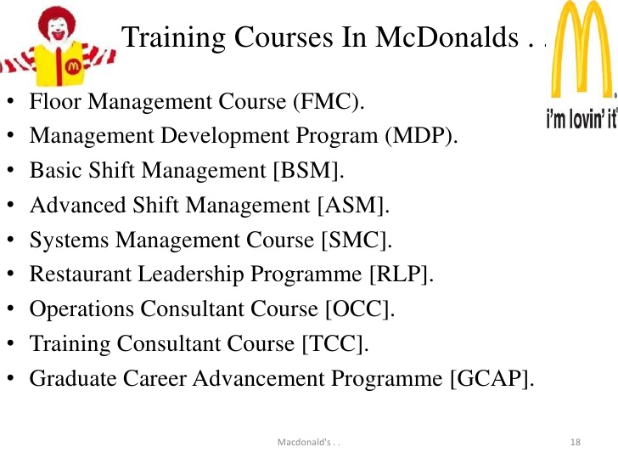
Operational level

Slide 11
SENIOR Management level
Young Leaders Management Programme
European Leadership Programme
Global Leadership Programme

Slide 12
Why do we need to coach and mentor?
Make 5 points

Slide 13
Why Coaching and Mentoring:
Output
Learning curve
Job satisfaction
Culture change
Legal factors
Leadership
etc

Slide 14
But why are employers reluctant to INVEST IN COACHING
AND MENTORING ?
Who pays?
What skills to develop?
Staff mobility?
Cultural: cost or investment?

Slide 15
Designing a simple coaching programme

Slide 16
COACHING process
Investigating Needs
Evaluate
Design
Deliver

Slide 17
Step 1
Identify needs

Slide 18

Observation

Slide 19


Slide 20

Critical Incident

Slide 21

Performance appraisal: Theory X -Theory Y

Slide 22

Quality Control

Slide 24
Design Coaching
Step 2

Slide 25
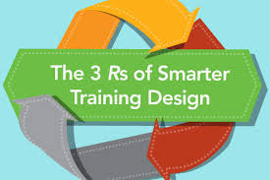

Slide 26
3 Rs
Relevance
Resources
Results

Slide 27
Delivering
STEP 3

Slide 28


Slide 29
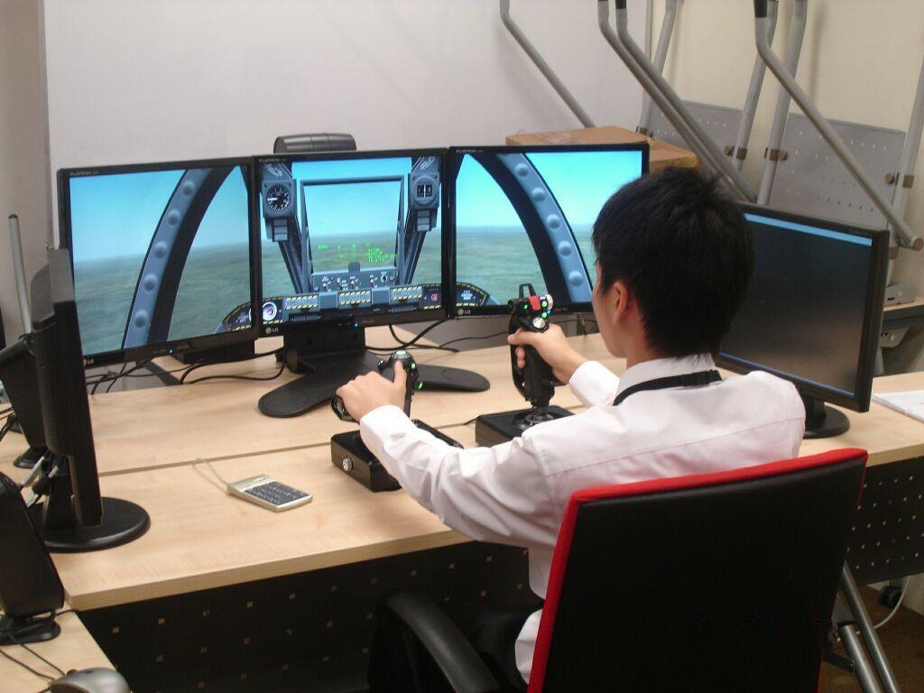

Slide 30


Slide 31

simulation

Slide 32
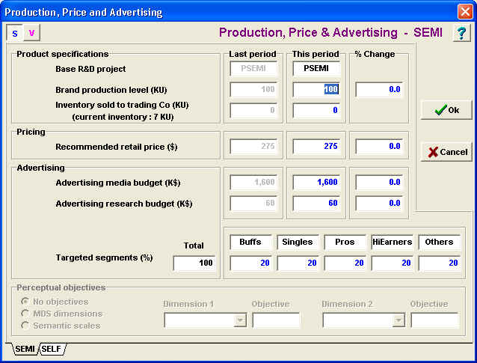
software

Slide 33
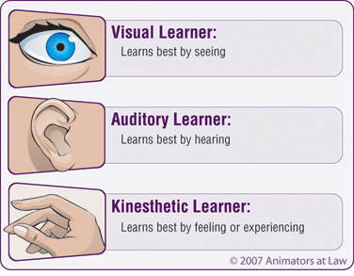

Slide 35
Evaluating

Slide 37
The process does not stop after the coaching:
the learning objectives have been achieved
the learning has been put into practice in the workplace
additional support and coaching is required
amendments need to be made to improve the activity in the future

Slide 38
Leadership and Management mentoring programme: Design issues

Slide 39
Studies by Handy and Storey (2000)
Costly
Staff mobility
Complex/ high-level of interpersonal skills
Long-term/ appraisal difficult
Context may not change in spite of individual development
Involves careers and career management

Slide 40
Mc Donald’s :SENIOR Management level
Young Leaders Management Programme
European Leadership Programme
Global Leadership Programme

Slide 41
Who should receive the mentoring?

Slide 42
Professional and managerial stock
 | High likelihood of promotion- HIGH | LOW
High | Stars | ?
Low | ? | ?

Slide 43
Loyalty Dilemma
 | Accept | Reject

Slide 44
Who will the mentors be?
Solid citizens? How will they benefit ?
Bearing in mind it’s a voluntary

Slide 45
Type of mentoring on offer
One-to-one
One-many
Many to one
Many to few

Slide 46
video
One to Many
IT'S POSSIBLE (Les Brown's Greatest Hits)

Slide 47
Structure of Mentoring
Bowman’s Leadership Training
Target and Shotgun Approach
Blake and Mouton Grid

Slide 48
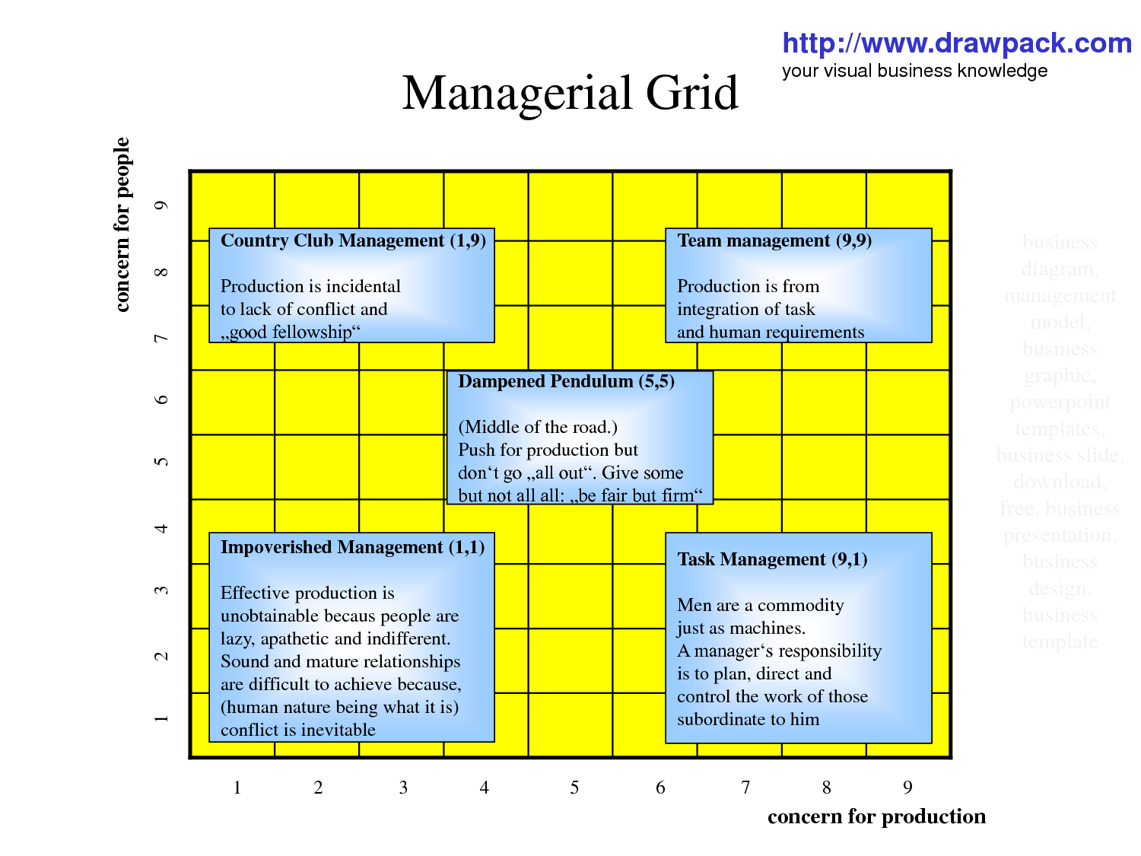

Slide 49
Team building : 12 Angry Men

Slide 50
Determine the goals of the mentoring programme

Slide 51
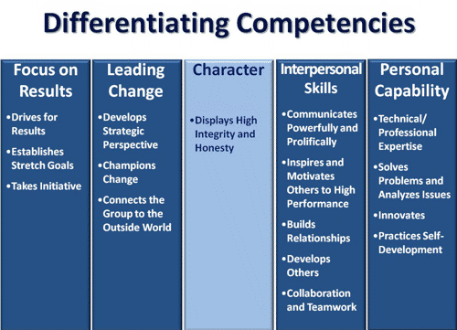
Choose one or a few from the menu

Slide 52
Frequency and length of meeting

Slide 53
Policy and financial plan
Where will it take place?
How many mentors?
Mentees?
Who should get it?
Diversity and equality? Mismatch between role model and ethnicity of mentee
How to evaluate success? Who should be the evaluators?
Budget

